Slide 1
OOPS CONCEPT IN JAVA
Weekly Assignment (Oct 2021)
Prepared By
S.PRIYA

Slide 2
What is OOPS?
OOP meaning “Object Oriented Programming” is a popularly known and widely used concept in modern programming languages like Java
The popular object-oriented languages are Java,C++,PHP, Python, etc.
Object-Oriented Programming System (OOPs) is a programming concept that works on the principles of abstraction, encapsulation, inheritance, and polymorphism.
It allows users to create objects they want and create methods to handle those objects.
The basic concept of OOPs is to create objects, re-use them throughout the program, and manipulate these objects to get
Advantages of OOPs (Object-Oriented Programming System):
OOPs Concepts in Java offer easy to understand and a clear modular structure for programs.
Objects created for Object-Oriented Programs can be reused in other programs. Thus it saves significant development cost.
Large programs are difficult to write, but if the development and designing team follow OOPS concepts, then they can better design with minimum flaws.
It enhances program modularity because every object exists independently.

Slide 3
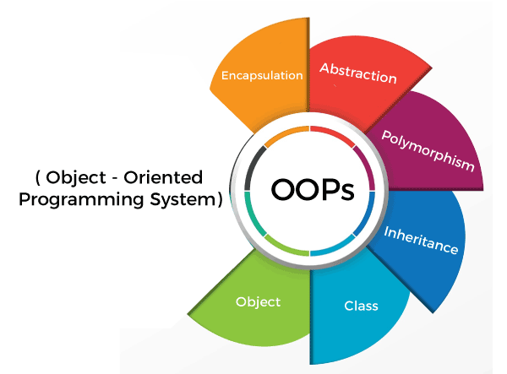
OOPs (Object-Oriented Programming System) Object means a real-world entity such as a pen, chair, table, computer, watch, etc. Object-Oriented Programming is a methodology or paradigm to design a program using classes and objects.
The following are general OOPs concepts in Java:
Object
class
Inheritance
Polymorphism
Abstraction
Encapsulation

Slide 4
Object
An entity that has state and behavior is known as an object e.g., chair, bike, marker, pen, table, car, etc.
An Object can be defined as an instance of a class.
An object contains an address and takes up some space in memory.
Objects can communicate without knowing the details of each other's data or code.
An object has three characteristics:
State: represents the data (value) of an object.
Behavior: represents the behavior (functionality) of an object such as deposit, withdraw, etc.
Identity: An object identity is typically implemented via a unique ID
How to create object
To create an objectof main,specify the class name, followed by object name and use keyword new:
Syntax:-
ClassName ReferenceVariable=new ClassName();
public class employee {
int x = 5;
public static void main(String[] args) {
employee myObj = new employee();{
System.out.println(myObj.x);}
}
Output
5

Slide 5
Class
A Class is like an object constructor, or a "blueprint" for creating objects.
It is a logical entity. It can't be physical.
A class in Java can contain:
Fields
Methods
Constructors
Blocks
Nested class and interface
Some real life example of class and object in java are:-
Class: fruits
Object: Man, Woman
Class: Mobile phone
Object: iPhone, Samsung, Moto
How to create Class
To create class, use keyword class:
A class should always start with an uppercase first letter.
The name of the java file must match the class name.
public class Main {
public static void main(String[] args) {
System.out.println(“welcome");
}
}

Slide 6
Inheritance
Inheritance in Java is a mechanism in which one object acquires all the properties and behaviors of a parent object.
The idea behind inheritance in Java is that you can create new classes that are built upon existing classes. When you inherit from an existing class, you can reuse methods and fields of the parent class.
Inheritance represents the IS-A relationship which is also known as a parent-child relationship.
To inherit from a class, use the extends keyword.
(extends is to increase functionaliy)
subclass (child) - Subclass is a class which inherits the other class
superclass (parent) - Superclass is the class from where a subclass inherits the features
The syntax of Java Inheritance
class Subclass-name extends Superclass-name
Class bank {
........
}
Class hdfc extends bank{
……
}
Example:-
class bank {
float salary=40000;
}
class Hdfc extends bank {
int bonus=10000;
public static void main(String args[]){
Hdfc obj1=new Hdfc();
System.out.println(" salary is:"+obj1.salary);
System.out.println("Bonus is:"+obj1.bonus);
}
}
OUTPUT:-
SALARY IS 40000
BONUS IS 10000

Slide 7
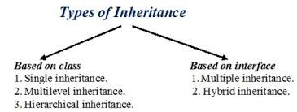
Types of inheritance There can be three types of inheritance in java: single, multilevel and hierarchical. In java programming, multiple and hybrid inheritance is supported through interface only.
Example
class car {
void brand ()
{ System.out.println(“audi");}
}
class model extends car {
void version ()
{ System.out.println(“gttron"); }
}
public static void main(String[] args) {
model obj1 = new model();
Obj1.version();
Obj1.brand();
}
}
Single Inheritance Example
When a class inherits another class, it is known as a single inheritance
Output:-
gttron
audi

Slide 8
Multilevel Inheritance
Example:-
class testing {
void whitebox ()
{ System.out.println(“developer will execute");}
}
class manual extends testing {
void blackbox ()
{ System.out.println(“test engineer will execute"); }
}
class automation extends manual {
void performance ()
{ System.out.println (“solution fixed"); }
public static void main(String[] args) {
automation obj1 =new automation();
Obj1. performance();
Obj1.whitebox();
Obj1.blackbox();}
}
Multi-Level Inheritance in Java, a class extends to another class that is already extended from another class.
For example,
if there is a class A that extends class B and class B extends from another class C, then this scenario is known to follow Multi-level Inheritance.
Output:-
Solution fixed
Test engineer will execute
Developer will execute

Slide 9
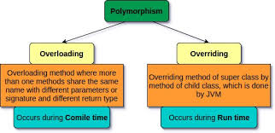
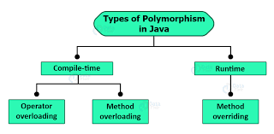
Polymorphism
Polymorphism allows us to perform a single action in different ways
The word polymorphism means having many forms.
In other words, polymorphism allows you to define one interface and have multiple implementations.
For example, smartphone for communication. The communication mode can choose could be anything. It can be a call, a text message, a picture message, mail, etc. So, the goal is common that is communication, but their approach is different. This is called Polymorphism.
polymorphism is mainly divided into two types:
Compile time Polymorphism
Runtime Polymorphism

Slide 10
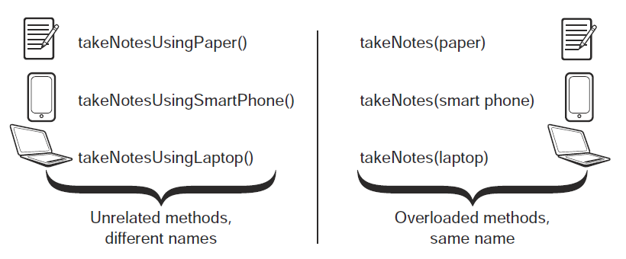
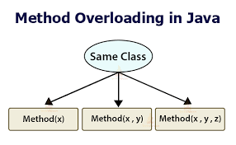
Method Overloading
If a class has multiple methods having same name but different in parameters, it is known as Method Overloading
Method overloading is performed within class.
Method overloading is the example of compile time polymorphism.
There are two ways to overload the method in java
By changing number of arguments
By changing the data type
Benefits of using Method Overloading
Method overloading increases the readability of the program.
This provides flexibility to programmers so that they can call the same method for different types of data.
This makes the code look clean.

Slide 11
Method Overloading
By changing the data type
By changing number of arguments
Example:-
class Qtree{
Void add(int a, int b)
{System.out.println(a+b); }
Void add(int a,int b,int c)
{System.out.println(a+b+c+); }
class TestOverloading1{
public static void main(String[] args){
Qtree obj1=new Qtree();
OBJ1.add(30,40);
Obj1.add(30,40,50);}
}
Example:-
class Qtree{
Void add (int x, int y)
{System.out.println(a+b); }
Void addd (double x,double y)
{System.out.println(x+y); }
class TestOverloading1{
public static void main(String[] args){
Qtree obj1=new Qtree();
OBJ1.add(30,40);
Obj1.add(10,20,);}
}
Output:-
70
110
output:-
70
30

Slide 12
Method Overriding
Example:-
class School{
void report()
{System.out.println(“final exam");}
}
class Student extends School{
void report()
{System.out.println(“rank assinged");}
public static void main(String args[]){
student obj1 = new student();
obj1.student);
}
}
If subclass (child class) has the same method as declared in the parent class, it is known as method overriding in Java.
In other words, If a subclass provides the specific implementation of the method that has been declared by one of its parent class, it is known as method overriding.
Usage of Java Method Overriding
Method overriding is used to provide the specific implementation of a method which is already provided by its superclass.
Method overriding is used for runtime polymorphism
Rules for Java Method Overriding
The method must have the same name as in the parent class
The method must have the same parameter as in the parent class.
There must be an IS-A relationship (inheritance).
Output:-
rank assinged

Slide 13
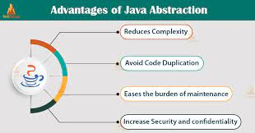
Abstraction
Abstraction is a process of hiding the implementation details and showing only functionality to the user.
Another way, it shows only essential things to the user and hides the internal details, for example, sending SMS where you type the text and send the message. You don't know the internal processing about the message delivery.
A class which is declared as abstract is known as an abstract class. It can have abstract and non-abstract methods. It needs to be extended and its method implemented. It cannot be instantiated.
//ABSTRACT CLASS WITH ONE ABSTRACT METHOD
Example:-
abstract class Bank{
abstract void homeloan();
}
class axis extends bank{
void homeloan(){
System.out.println(“interest is 5");}
public static void main(String args[]){
bank obj1 = new axis(); obj1.homeloan();
}
}
Output:-
Interest is 5

Slide 14
Interface
Example for multiple inheritance
interface axisbank {
void homeloan ();
}
interface Sbibank{
void homeloan ();
}
class boibank implements Axisbank, sbibank{
public void homeloan()
{System.out.println(“ interest is15/");}
public static void main(String args[]){
boibank obj = new boibank();
Obj.homeloan();
}
}
An interface in Java is a blueprint of a class. It has static constants and abstract methods.
The interface in Java is a mechanism to achieve abstraction
An interface is declared by using the interface keyword.
It provides total abstraction; means all the methods in an interface are declared with the empty body, and all the fields are public, static and final by default
Java Interface also represents the IS-A relationship.
Uses of Java interface
It is used to achieve abstraction.
By interface, we can support the functionality of multiple inheritance.
It can be used to achieve loose coupling.
Output:-
Interest is 15/

Slide 15
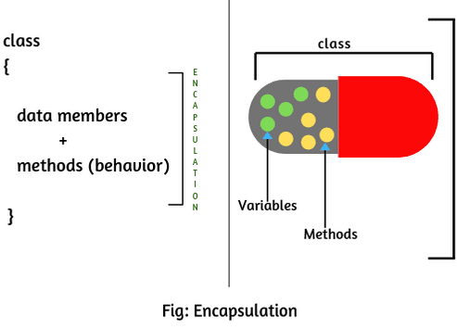
Encapsulation
Binding (or wrapping) code and data together into a single unit are known as encapsulation. For example, a capsule, it is wrapped with different medicines.
A java class is the example of encapsulation. Java bean is the fully encapsulated class because all the data members are private here.
Advantage of Encapsulation in Java
By providing only a setter or getter method, you can make the class read-only or write-only. In other words, you can skip the getter or setter methods.
The encapsulate class is easy to test. So, it is better for unit testing.

